Slide 1
BSIT 5th semester
Lecture 1

Slide 2
Definition and meaning of Price elasticity of supply
Price elasticity of supply (Pes or Es) measures the relationship between change in quantity supplied and a change in the good’s own price.
The degree of responsiveness in quantity supply of a commodity, due to change in its price.

Slide 3


Mathematically it can be written as;
Es represents elasticity of supply

Slide 4
Possibilities of elasticity of supply
When elasticity of supply is measured, following five possibilities are arises.
Elasticity equals to unity (Es=1)
Elasticity more than Unity (Es>1)
Elasticity less than unity (Es<1)
Zero elasticity (Es=0)
Infinite elasticity (Es= )

Slide 5
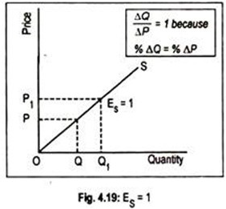


1. Elasticity equals to unity (Es=1)
If percentage change in quantity supply equals to percentage change in price then elasticity of supply will be equal to one.
P QS
5
10
100
200
P=5,
Change in p=10-5=5 Q=100
Change in Q=200-100=100
Es=1
Normal curve

Slide 6
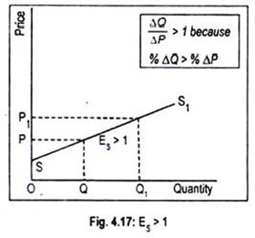


2. Elasticity more than Unity (Es>1)
(Elastic supply)
Supply is said to be elastic when a given percentage change in price leads to a larger change in quantity supplied. Under this situation, the numerical value of E_{s} will be greater than one but less than infinity.
P
5
10
QS
100
300
Es>1
flatter curve

Slide 7
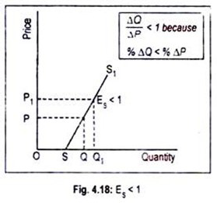

3. Elasticity less than unity (Es<1)
(Inelastic Supply)
Supply is said to be inelastic when a given percentage change in price causes a smaller change in quantity supplied. Here the numerical value of elasticity of supply is greater than zero but less than one.
P
5
10
QS
100
150
Es<1
steeper curve

Slide 8
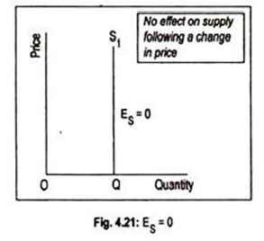

4. Zero elasticity (Es=0)
( Perfectly Inelastic Supply)
When there is no change in quantity supply of a commodity, due to change in price of a commodity then elasticity of supply will be equal to zero.
Here the supply curve has been drawn parallel to Y-axis or the vertical line
P
5
10
QS
100
100
Es=0

Slide 9
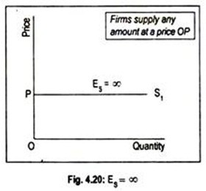

5. Infinite elasticity (Es= )
(Perfectly Elastic Supply)
The numerical value of elasticity of supply, in exceptional cases, may reach up to infinity.
Infinite(unlimited)change in quantity supply, due to no change in price, then elasticity of supply will be infinite.
Here the supply curve has been drawn parallel to x-axis or the horizontal line.
P
5
5
QS
100
1000

